Slide 1
Autonomous Ground Vehicle Spring 2015
Team Members:
Spencer Lee – slee163@ucr.edu
Ryan Sabik – rsabi001@ucr.edu
Billy Xiao – bxiao001@ucr.edu

Slide 2
Technical Design Objectives
Design Objectives:
Wifi communications:
To relay manual commands within 250ms:
Current Status such as speed, proximity around device, etc.
UltraSonic Sensors:
Used for proximity sensor, self-navigating including collision avoidance.
Used precisely between 3-4 ft.
Arduino (Addition)
Power Consumption: Uses 8-10 watts
Processor chosen to control the peripherals
DC motors, servos, and ultrasonic sensors
Large amount of open source libraries
Raspberry Pi:
Processor used for communication with the computer, Arduino, and webcam for video feed
Power consumption: about 8-10 watts
Small Form factor and allows a large amount of USB peripherals
Notes:
Slide 3: Technical design objectives, be specific and should be measurable (numerical), e.g., response time, frequency or transmission range, SNR, accuracy, false alarm rate, power consumption, capacity, etc. List any changes from your design review presentation in 175A

Slide 3
Concepts and Application of Design
What are we designing?
We designed an Unmanned-Autonomous Ground Vehicle
Some of the technical principles we are covering are:
As a team, we developed skills in project management and learned how to further understand datasheets
What are the intended applications?
We intend this to further increase the possibilities of automobiles operating on its own without a driver and be able to relay current information back to the user.
This is related to electrical engineering because we deal with signal processing, manipulation of frequency to drive motors, and use electrical components that we learned over the years.
Notes:
Slide 2: Concept and application of the design: What did you design, technical principles, why this is a meaningful project, what are the intended applications, how is it related to subjects in electrical engineering. List any changes from your design review presentation in 175A

Slide 4
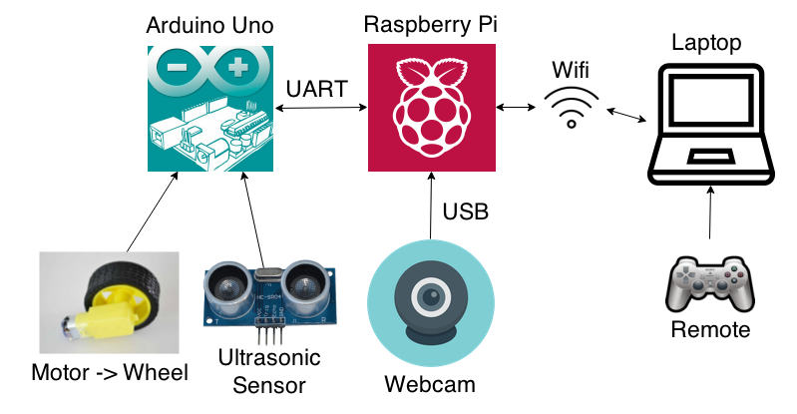
Final High Level Design
Notes:
Slide 4: Final high level design, show block diagram of the system. Highlight any changes from your design review presentation in 175A

Slide 5
Technical Challenges
Wifi Challenges:
TCP vs UDP
Originally had problem with Wifi speed because of TCP. TCP requires to have a full packet in order to transmit, as opposed to UDP, where UDP does not have this restriction.
UDP
Fixed our speed problem, but we accidentally transmitted too often, which created a delay in response time of our UGV.
Ultrasonic
Tried to simulate software interrupt, fixed with hardware
Notes:
Slide 5: Technical challenges, what are the difficult electrical engineering related technical problems you encountered and solved, was there any difficulty that you were unable to solve, and how have you changed your design to get around it?

Slide 6
Technical Challenges
Communication Issues
Having the Raspberry PI send and receive data to and from the Arduino.
Determining the proper packet size and data type for accuracy and speed
Sending the video feed to the computer
Finding how to send and decipher a stream of frames using the Pygame library
Motor Driver Module
Kept frying these chips up

Slide 7
Major Components and Responsibilities
Major Components and Contributor | Description
Raspberry Pi: Spencer Lee | Initializing, startup, network link to computer and remote control
Arduino: Billy Xiao | Manipulated Ultrasonic Sensors and used these sensors to manipulate motors that drives the wheel
Sensor: Ryan Sabik | Researched Datasheet and other online resources to setup these sensors and work them correctly
Networking: Spencer Lee Ryan Sabik | Researched different protocols to establish a communication between the Laptop Computer (host) and the UGV as well as Playstation Remote to relay commands to UGV
Hardware Billy Xiao | Modified any necessary hardware to function with UGV
Video Streaming Ryan Sabik | Researched how to record and send a series of frames through ports using open source libraries
Notes:
Slide 6: Major components of the design and implementation, and who contributed to what

Slide 8
Design Considerations
Budget: $300 - $375
Actual Spent: ~$240
Control Unit
Raspberry Pi:
Powerful to relay Image/Video Processing
Has peripheral capabilities for Wifi, Camera, etc.
Arduino Uno:
Small form factor with enough processing power to manipulate sensors and control both types of motors using the motor drivers
Power
Battery used needs to provide a reasonable amount of milliamp hours (Currently 10,000)
Battery needs to be small enough to fit into vehicle, slim enough to fit between crevice
Notes:
Slide 7: Design considerations: * Realistic constraints (time, skill, power consumption, weight, size, microcontroller speed, memory size, sampling rate, data rate, costs (this is for weighing the costs of different design decisions. Do NOT simply show a list of parts and their costs), etc. * What industry standards did your project involve? e.g., 802.11, Bluetooth, I2C, USB, RS232, Zigbee, etc. How using the industry standards affected/constrained your design? (e.g., data rate, voltages, connectors, compatibility with other devices, etc.) List any changes from your design review presentation in 175A

Slide 9
Test Report
Drive Responsiveness:
Remotely:
For controls from controller: responds almost instantaneously
Video feed: Acceptable quality, good enough for live feed back
Autonomously:
Ultrasonic responds well, except on material that tends to reflect ultrasonic poorly, i.e. Carpet and Rubber moulding on walls
Drives around obstacles efficiently, with close to continuous movement
Does not take an extreme (>1 second) amount of time processing
How close did it come to our Design Specification?
Comparing our end product to our design, we would like to say our UGV came pretty close
Notes:
Slide 8: Test report: how did you test the system, what are the test results (in quantitative measures), how close did you come to your design specification? Slide 9: A real demo or a demo video is

Slide 10
Video Demo

Slide 11
Summary
Our Project:
Central Hub: Laptop
Established network and shows status of UGV
Central Processing: Raspberry Pi
Wifi through peripheral, relays Video feed from camera and process speed and other status via UART
Drive Train Intelligence: Arduino
Controls Ultrasonic and Motors to drive the UGV
In Conclusion:
A self driving vehicle that can also be controlled remotely and has status reports such as speed and Video Feed back

Slide 12
Acknowledgement
Professor Gang Chen
Design Strategies and considerations
Pavle Kirilov
Helping us with hardware difficulties
Google
For online resources and difficulties we encountered
Developers of Pygame, Pyserial and OpenCV
Chris Dube, Benson Ninh and Calvin Nguyen
For lending us a spare motor driver module
Notes:
Slide 11: Acknowledgment of people helped you or provided you with the design concept or ideas

